Slide 1
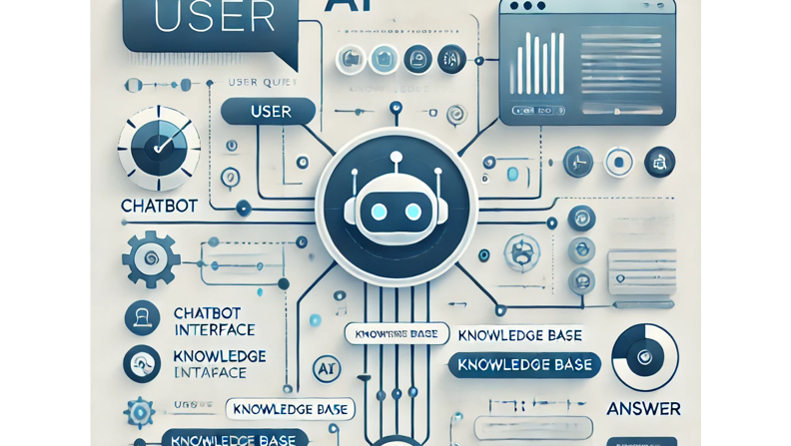
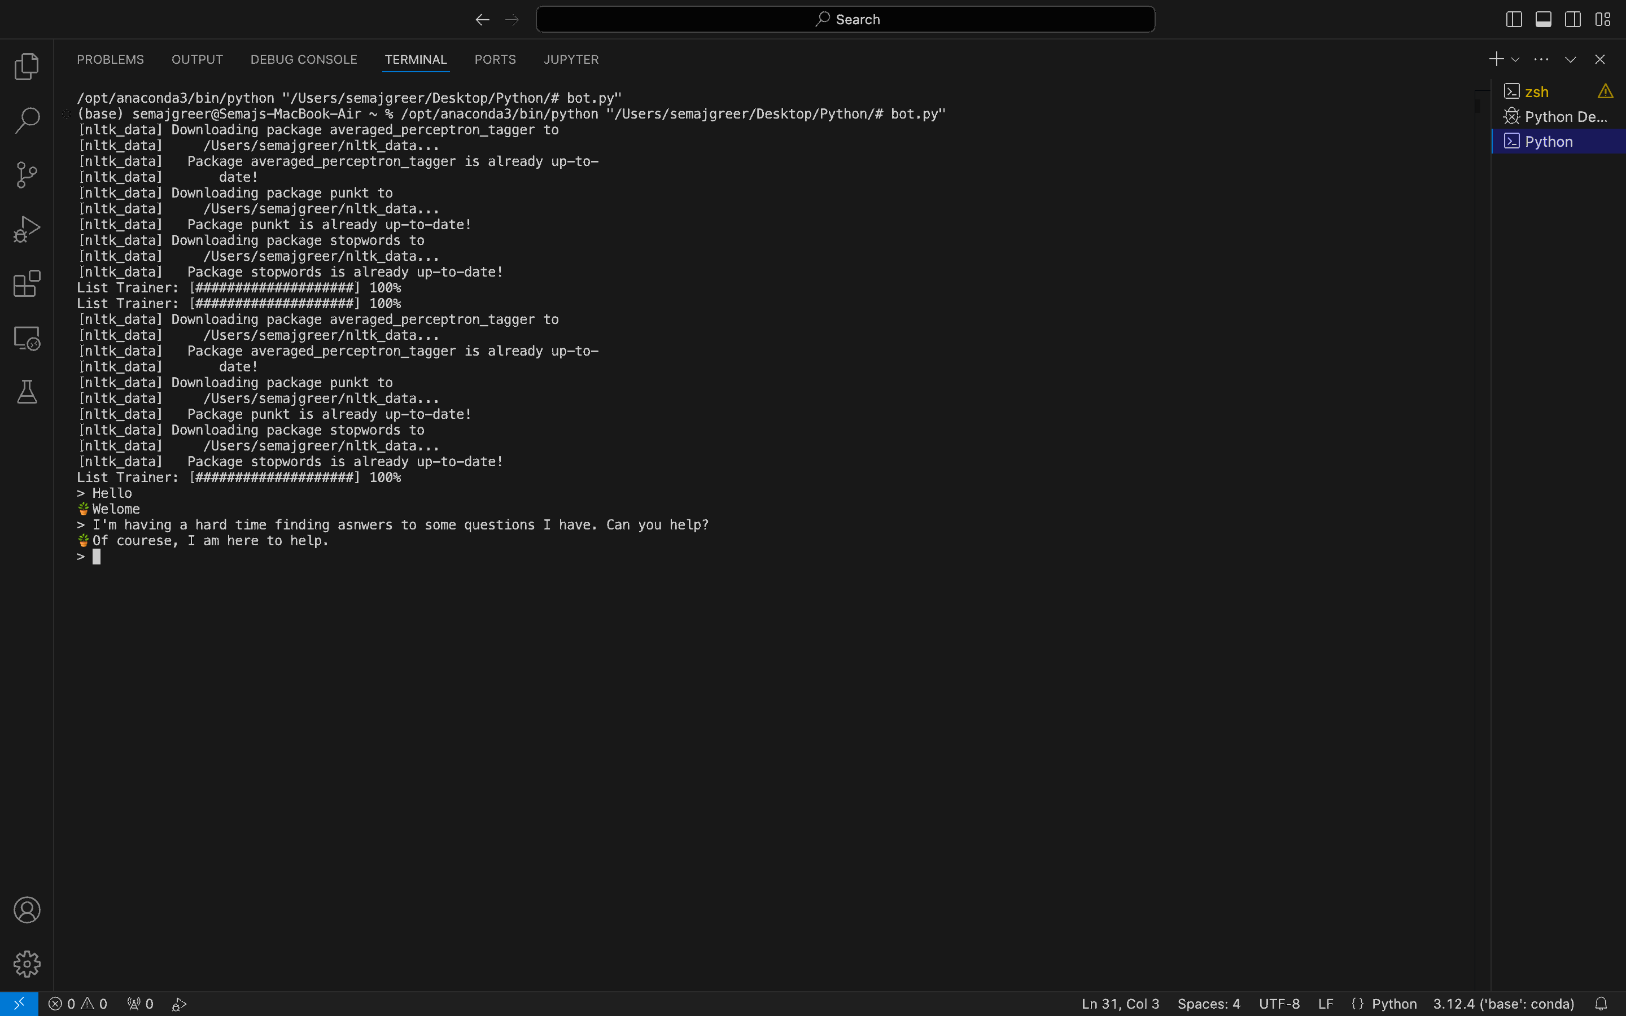
AI CHATBOT
Direct Answers, Simplified
https://github.com/sgreer16/chatbot.git
Created with Python and AI, by Semaj Greer

